Slide 1

Wiki Gaming
Week 2
The Larger Group
Intro
1
Catalog
2 3
User Forms
4
Accounts
5
Voting
6
Marketing
7
Overall
8

Slide 2
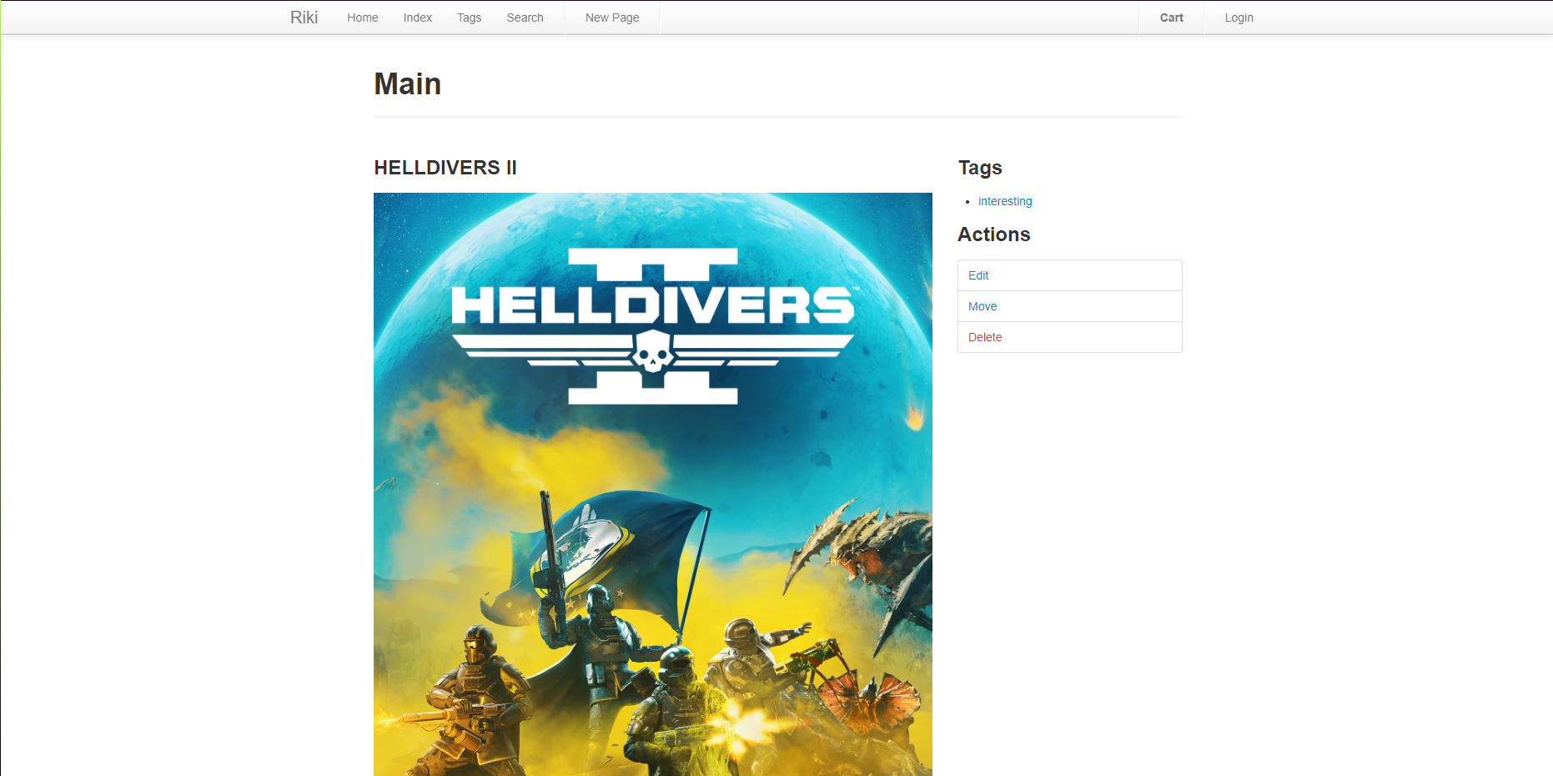
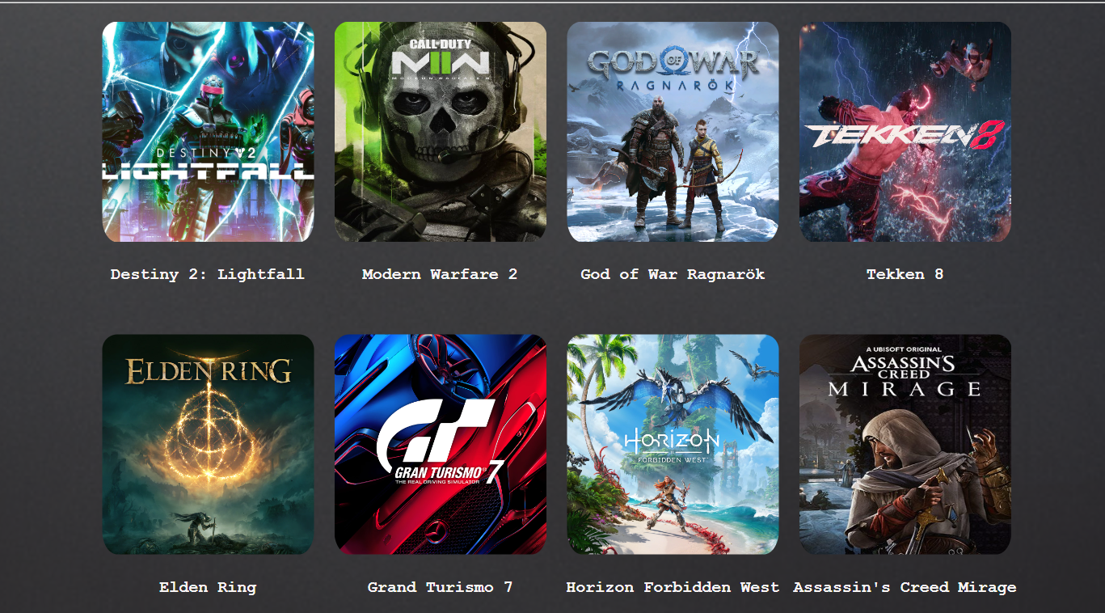
The Catalog
Requirement
As a User, I want to see a Game Catalog, so I can browse what games are out.
Lines of Code: 19
Issues with running Riki
Tests: 0/24
Burndown: 15%
Intro
1
Catalog
2 3
User Forms
4
Accounts
5
Voting
6
Marketing
7
Overall
8

Slide 3
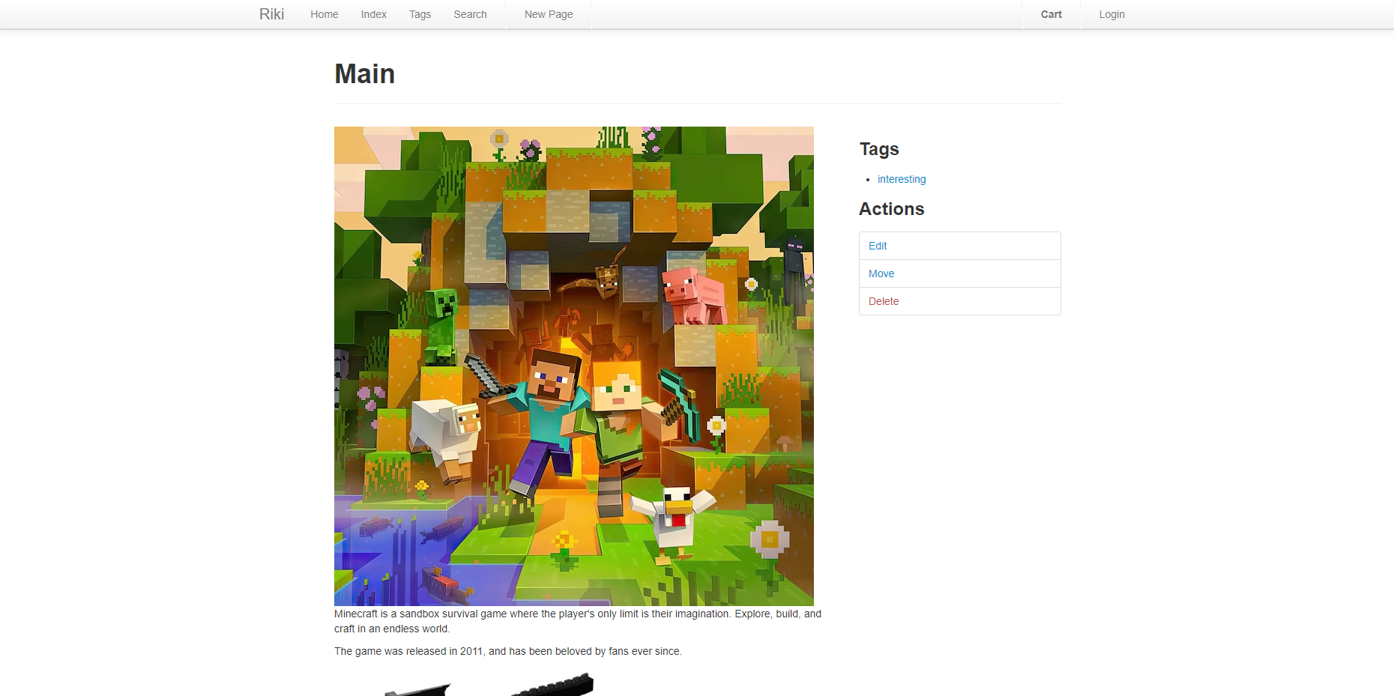
Individual Games
Requirement
As a User, I want to be able to see Game Forms, so that I can know what these games are about.
Lines of Code: 34
Issues with running Riki
Tests: 0/12
Burndown: 10%
Intro
1
Catalog
2 3
User Forms
4
Accounts
5
Voting
6
Marketing
7
Overall
8

Slide 4
User Forms
Requirements
As a User, I want to be able to speak to others, so that I can know what others think about these games.
Lines of Code: 0
Issues with running Riki
Tests: 0/12
Burndown: 0%
Intro
1
Catalog
2 3
User Forms
4
Accounts
5
Voting
6
Marketing
7
Overall
8

Slide 5
User Accounts
Requirements
As a User, I want a User Profile, so that I can know what I have said and save what I am interested in.
Lines of Code: 0
Not enough hours
Tests: 0/15
Burndown: 0%
Intro
1
Catalog
2 3
User Forms
4
Accounts
5
Voting
6
Marketing
7
Overall
8

Slide 6
Community Voting
Requirements
As a User, I want to vote on games and comments, so that I can say what I enjoy and see what others also enjoy.
Lines of Code: 0
Issues with running Riki
Tests: 0/24
Burndown: 0%
Intro
1
Catalog
2 3
User Forms
4
Accounts
5
Voting
6
Marketing
7
Overall
8

Slide 7
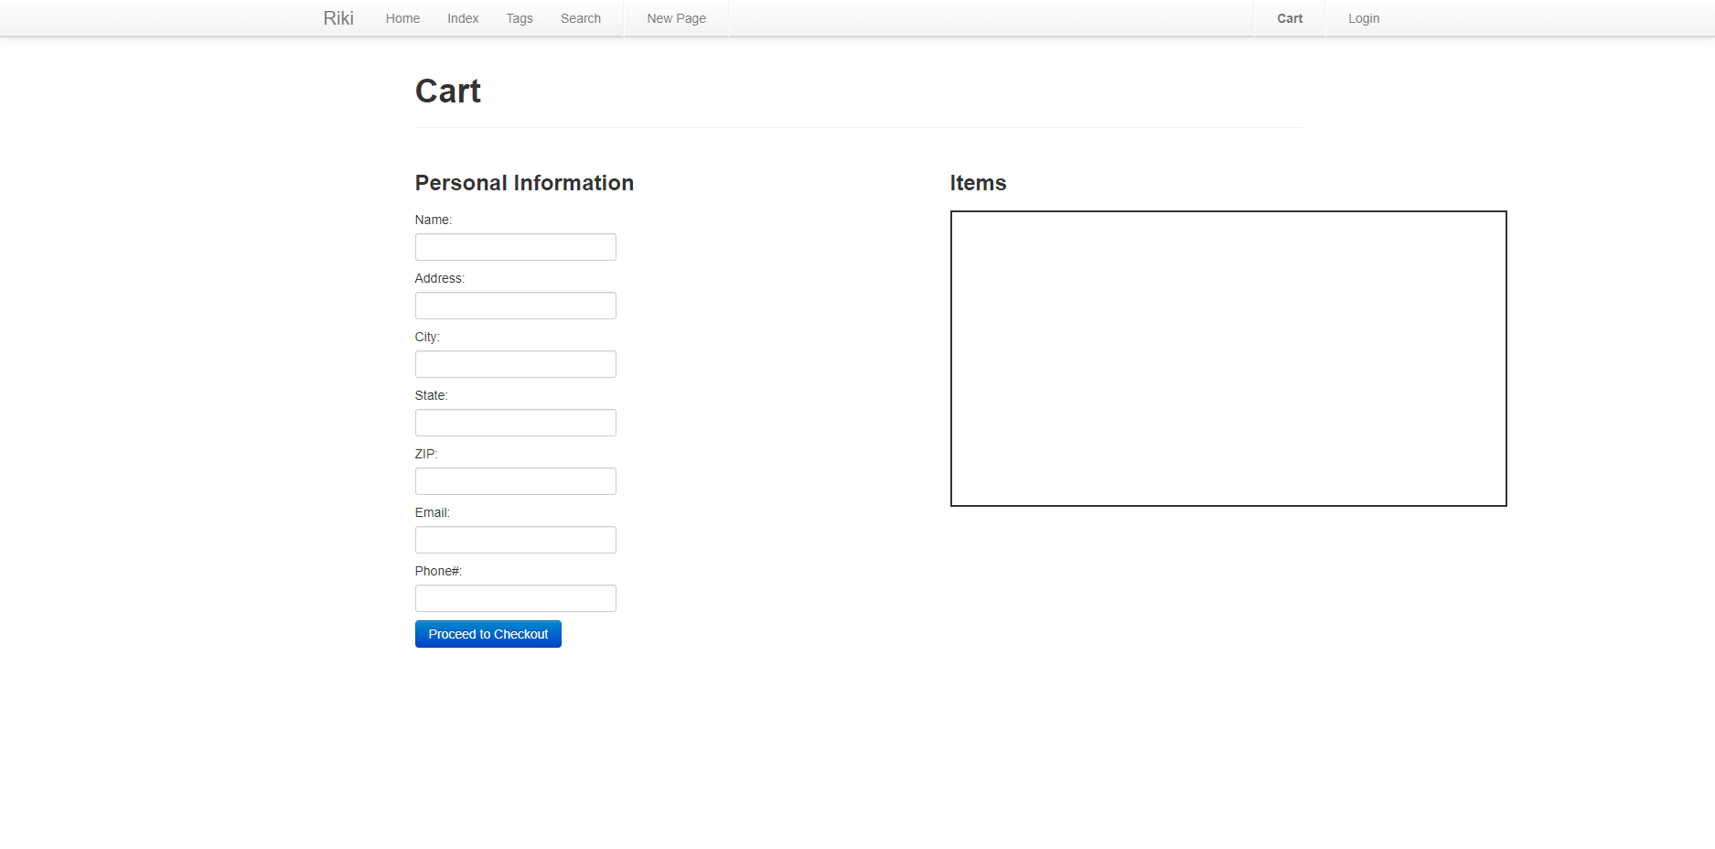
Marketing
Requirements
As a User, I want a market system, so that I can quickly buy games that I find interesting.
Lines of Code: 83
Tests: 0/12
Burndown: 20%
Intro
1
Catalog
2 3
User Forms
4
Accounts
5
Voting
6
Marketing
7
Overall
8

Slide 8
Overall
Lines of Code: 136
Tests: 0/99
Burndown: 10%
Milestone 2
Date: 3/31/2024
Goal: Finish creation/clean up of individual features, start implementing features together.
Risks
Issues with running Riki
Intro
1
Catalog
2 3
User Forms
4
Accounts
5
Voting
6
Marketing
7
Overall
8

